Slide 1
Saskatchewan Asbestos Disease Awareness Organization

Slide 2
Our Mission
For all levels of government to adopt the World Health Organization's recommendation to call for an end to the use of asbestos.
For municipal, provincial, and federal governments to establish a public registry reporting the location and condition of asbestos in public and commercial buildings.
To raise awareness about the dangers of asbestos.

Slide 3
Today’s Mission
Canada’s Asbestos History
Where Are We Now?
Where Are We Going
What Can You Do?

Slide 4
Why is asbestos a big deal?
Mesothelioma
Asbestosis
Lung Cancer
Economic Burden
Social Costs

Slide 5
Why Is Asbestos Still a Problem in Canada?
3 Waves
Government Involvement
Asbestos Industry

Slide 6
“Enough is enough. We have the right to know.”
-Howard Willems
More than 2000 asbestos related deaths in Canada annually
30% of worker fatalities in Saskatchewan each year are linked to asbestos
Numbers continue to rise
Mesothelioma cases have more than doubled in the last 20 years

Slide 7
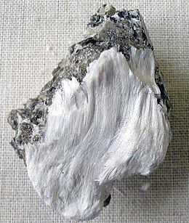
Canada’s Love Affair With Asbestos

Slide 8
https://www.youtube.com/watch?v=vilq93VmQrw

Slide 9
https://www.youtube.com/watch?v=LkB9Xoyj1Qk

Slide 10
Where Are We Now?

Slide 11
Saskatchewan Introduces First Asbestos Registry
November 2, 2012 private member’s bill introduced in Saskatchewan Legislature.
Coalition between SADAO, Canadian Cancer Society, Saskatchewan Lung Association and PSAC formed.
Campaign to create a provincial registry launched February 28, 2013
Howard’s Law passes unanimously April 18, 2013

Slide 12
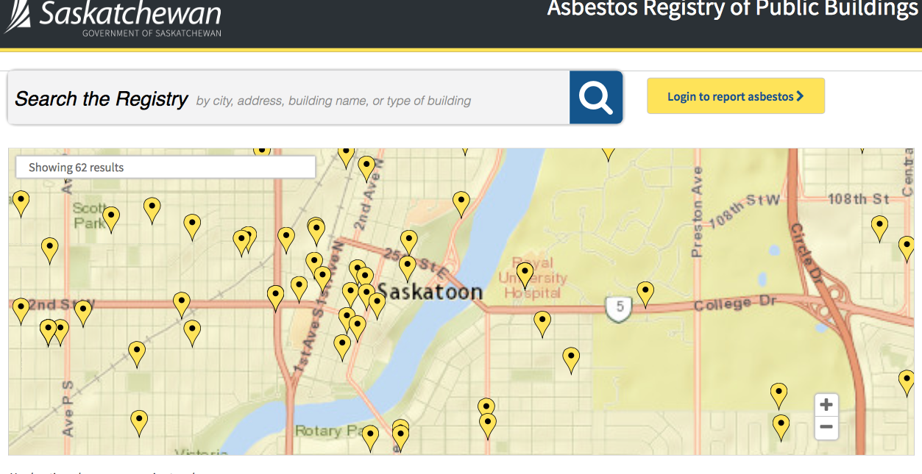
Saskatchewan Asbestos Registry

Slide 13
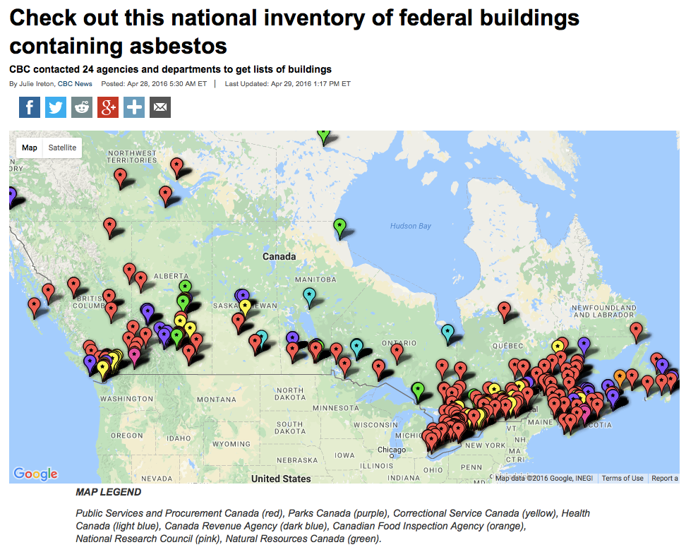

Slide 14
What Else Can Be Done?
Expand the current registry
Patient Registry
Certification Standards

Slide 15
Canadian Government Announces Ban on Asbestos
Announcement made December 2016
Ban to take effect before the end of 2018
Ban of imports, exports and manufacturing of asbestos products

Slide 16
Canada Bans Asbestos.
That’s Good, Right?
Well…..

Slide 17
A Comprehensive Asbestos Strategy
Develop a detailed asbestos strategy for Canada and an implementation framework
Move forward on key regulatory and policy initiatives
Play a leadership role in international action on asbestos

Slide 18
A Comprehensive Asbestos Strategy
Document asbestos exposure locations, exposed people and their health conditions; and develop a long term strategy for eliminating asbestos from our built environment
Ensure the protection of workers and the public in asbestos remediation and disposal
Promote safe alternatives to asbestos

Slide 19
A Comprehensive Asbestos Strategy
Ensure a just transition for affected workers, communities and businesses
Develop a comprehensive research and health response to asbestos diseases
Ensure fair compensation to victims of asbestos disease

Slide 20
What Can We Do?

Slide 21
Jesse Todd
jesse@sadao
306-203-1204

